Slide 1
Visualization of a Large Number of 3D Points Using Linear Embedding
Tay Truong
Weiting Liao
CSC664 Multimedia Systems

Slide 2

About Project
-Creating ways to make high dimensional
data more immersive & exploratory
-Visualizes patterns & relations in data
rather than query from a table

Slide 3
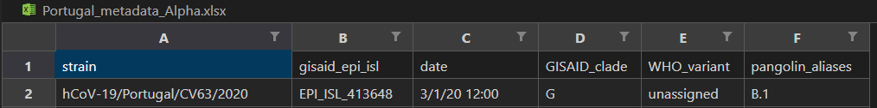
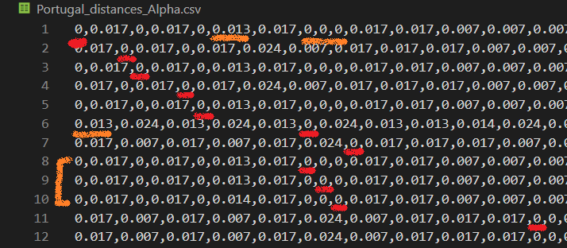
Data Being Used
-Cases of COVID-19
-Israel & Portugal
-xlsx & csv files
-approx. 5000x5000

Slide 4
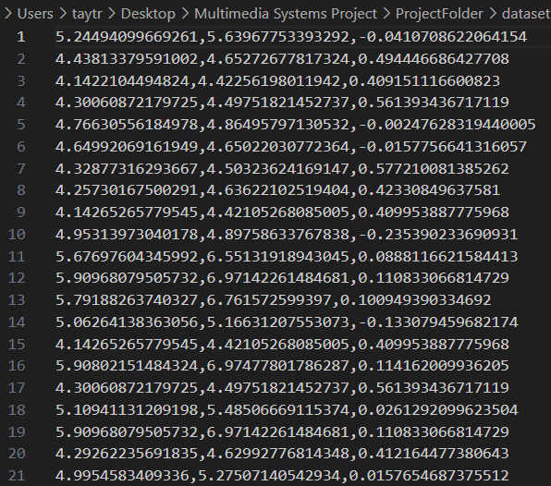
Data & Processing: Principal Component Analysis
-Applying PCA, we preserve 3
components
-Each serving as a coordinate in our
3D space (x,y,z)

Slide 5
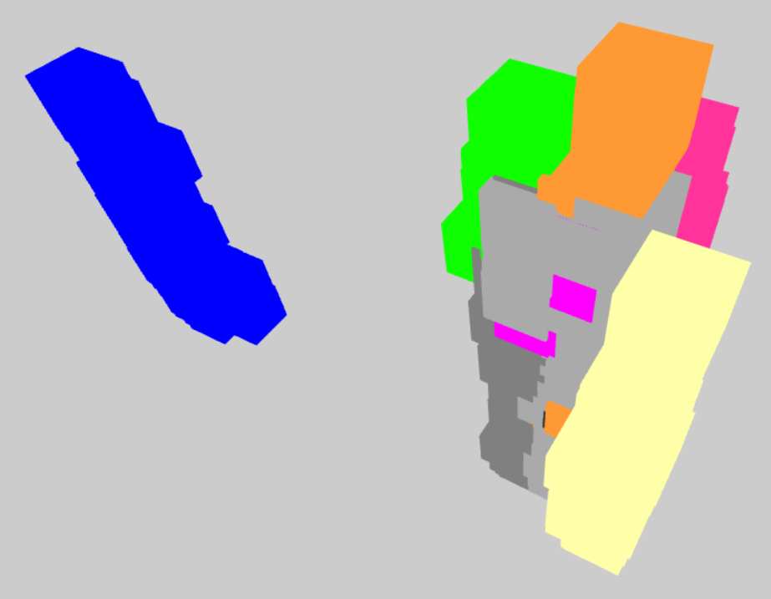
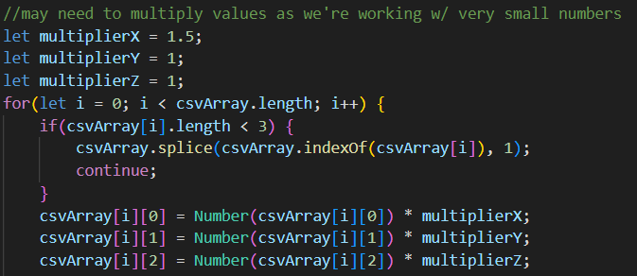
Formatting Data for 3D Display
-Adjust point size so intersecting
points can be seen
-Multiply (x,y,z) such that points are
more distinguishable
-Shift points with overlapping (x,y,z)

Slide 6
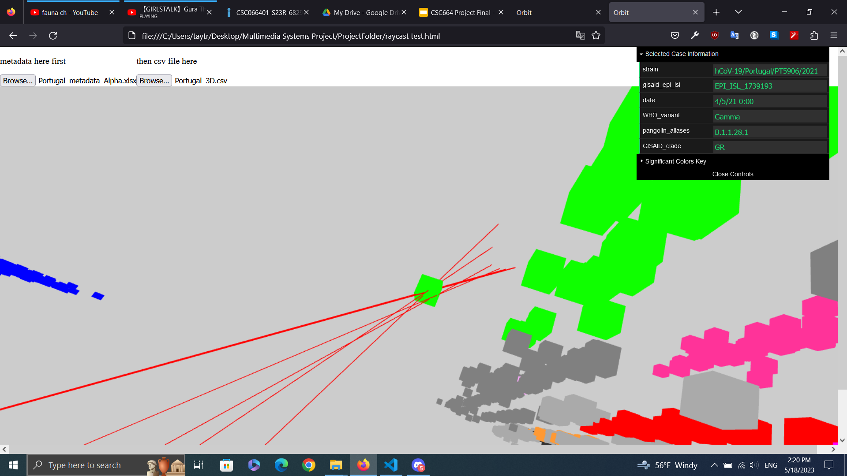
Navigating 3D Space
-Implementation in threeJS
-Camera orbit, pan & zoom
-Raycasting: clicking / hovering brings up
metadata
-Points color-coded based on significant
pangolin-aliases

Slide 7
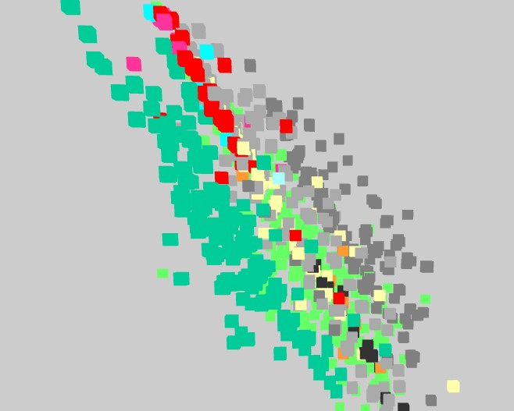
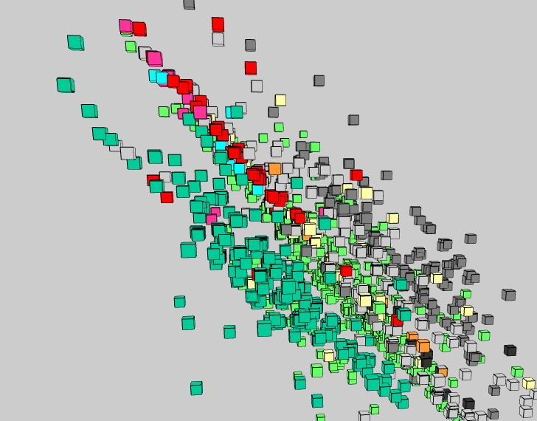
Adding Edges
-Adding edges to each 3D point can significantly improve the visual effect

Slide 8
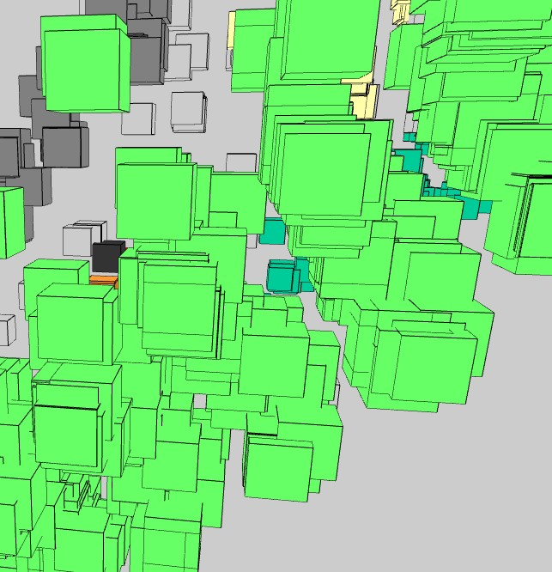
Overlapping
-Many 3D points have having exactly the same
coordinates.
-shift one of the overlapping points randomly
along one axis (x, y, or z) by a small amount
-Better approach, T-SNE or 3d-force.

Slide 9
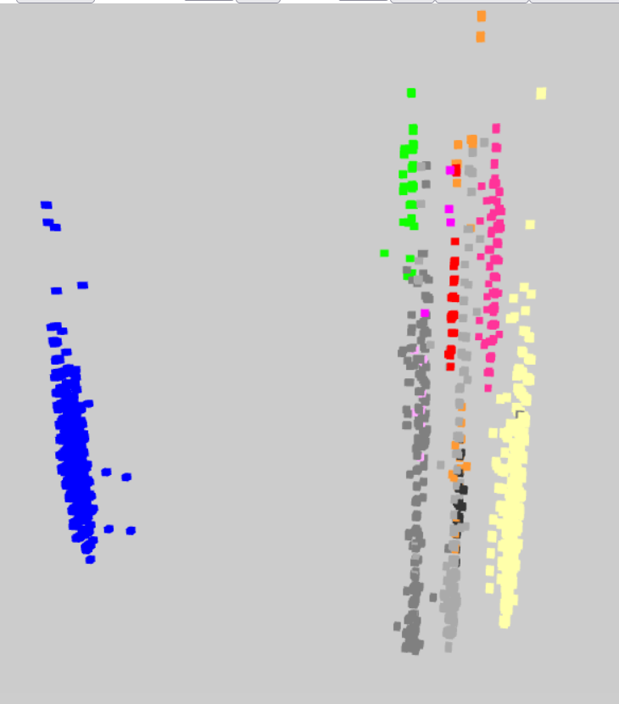
Resulting Environment
-Visualize cases of covid, each a point in
3D space
-Can pull up metadata of highlighted points
-Can adjust certain parameters in display

Slide 10
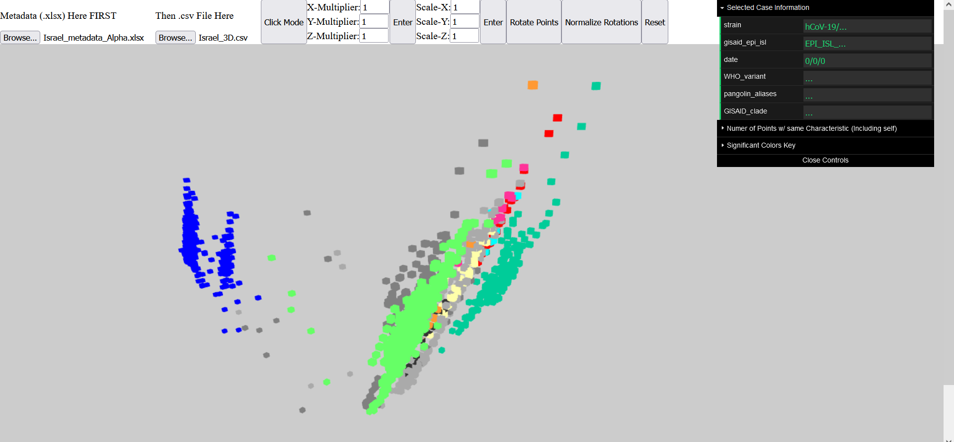
Demo

